Slide 1
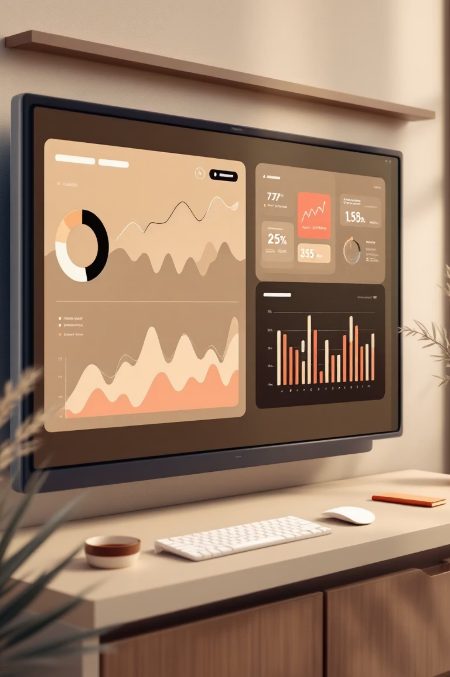
Customer Behaviour Analysis
A Data-Driven Analysis of Purchase Drivers

Slide 2

Business Problem
Segment Understanding
Product Drivers
Lack of granular insight into most valuable customer segments
Which features drive higher spending and positive feedback?
Operational Factors
How shipping, discounts, and payment methods influence purchases

Slide 3
Project Deliverables
01
02
Data Preparation Report
Segment Analysis
Processed CSV with null values handled, data types assigned, categorical variables encoded
Identify high-frequency, high-spending customers
03
04
Optimization Recommendations
Interactive Dashboard
Payment method comparisons and subscription impact analysis
Dynamic Power BI tool for ad-hoc exploration by stakeholders

Slide 4
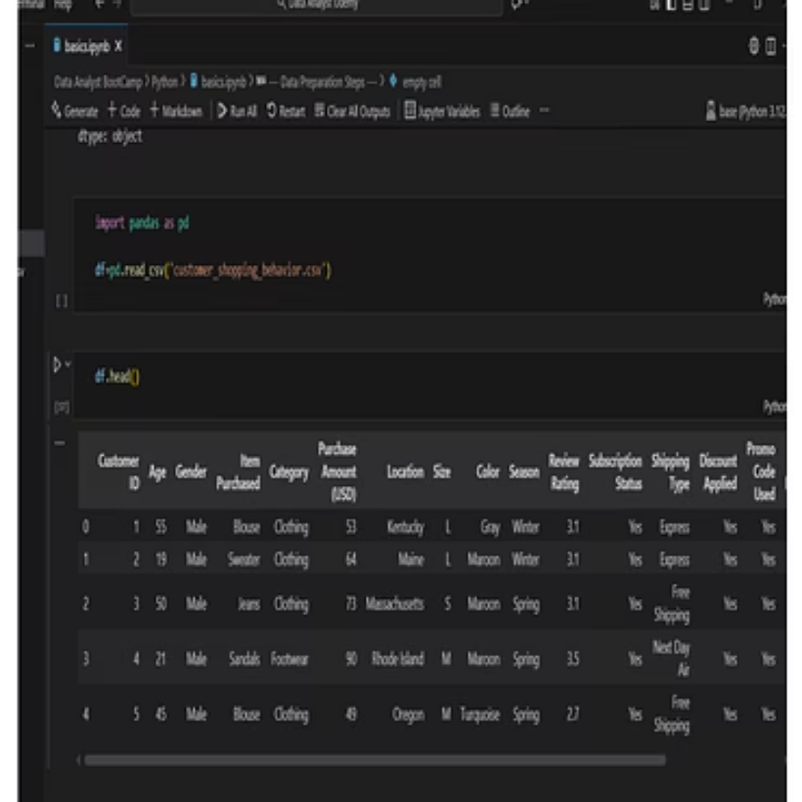
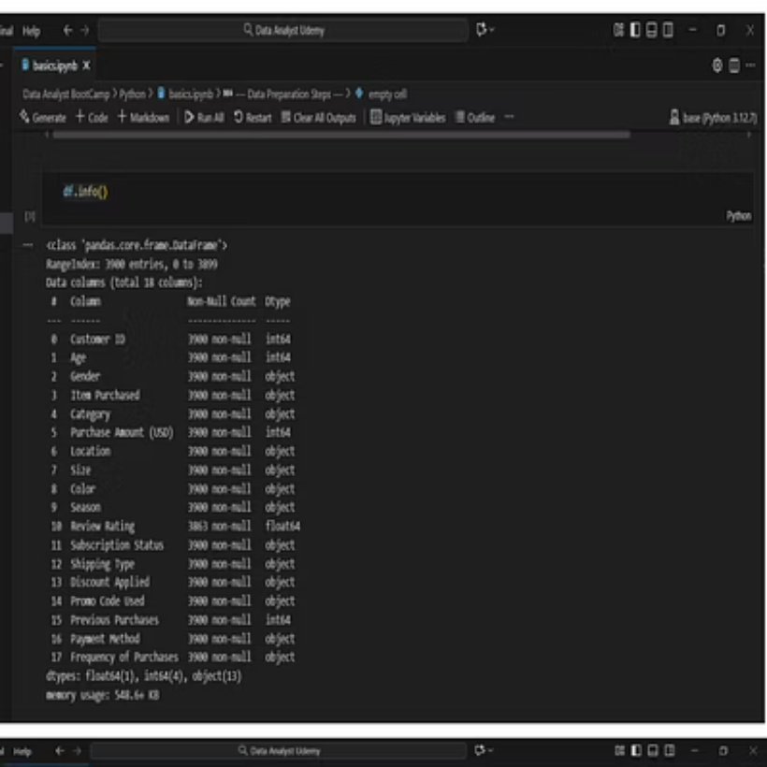
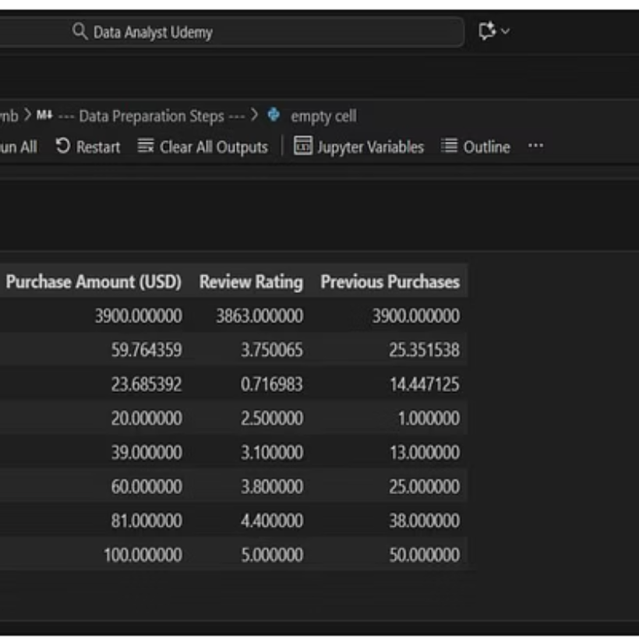
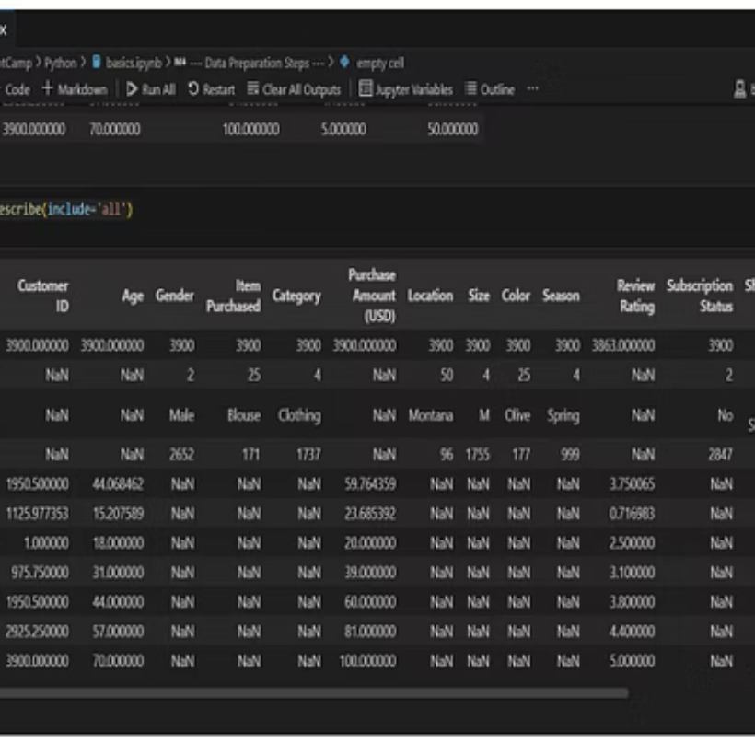
Data Preparation Using Python
Comprehensive data cleaning and transformation pipeline

Slide 5
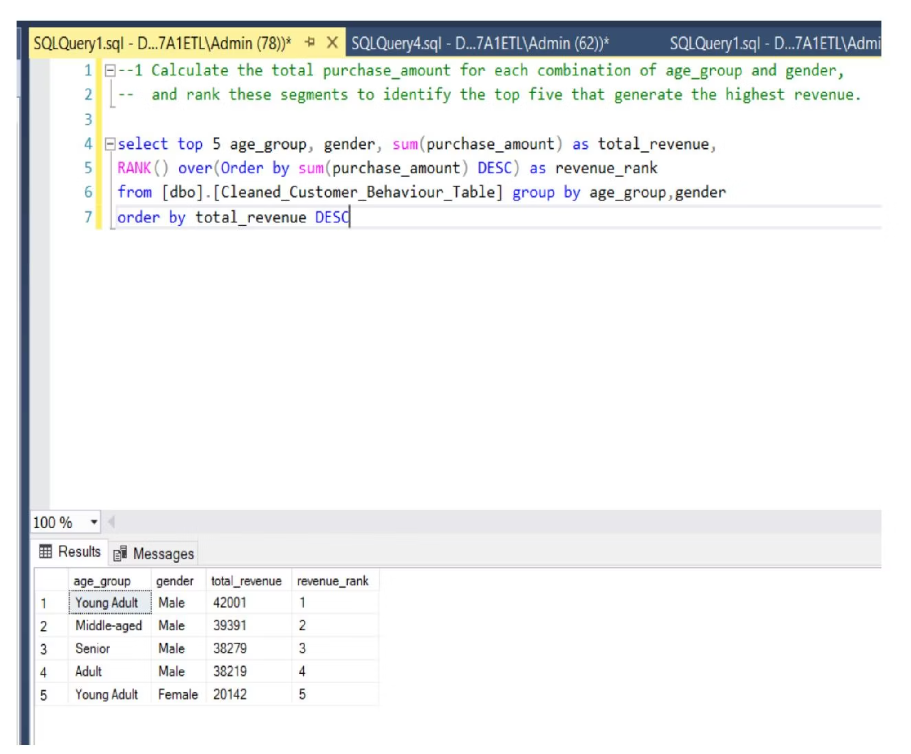
Subscription Impact Analysis
$59
With Subscription
Average purchase amount
30
Median Frequency
Days between purchases
Subscribers show consistent purchasing patterns

Slide 6


Seasonal Category Performance
Fall
Clothing leads with $26,220 total sales
Average rating: 3.71
Spring
Clothing generates $27,692
Average rating: 3.76
Summer
Clothing reaches $23,078
Average rating: 3.68
Winter
Clothing peaks at $27,274
Average rating: 3.73

Slide 7


Discount Impact by Size
0%
0%
Large
Medium
No difference: $58 with or without discount
No difference: $59 with or without discount
5%
5%
Small
Extra Large
$3 higher without discount ($62 vs $59)
$3 higher without discount ($61 vs $58)
Discounts show minimal impact on purchase amounts across most sizes

Slide 8

Top Revenue Locations: Shipping Analysis
California
Montana
Next Day Air: 20 items, 105 days avg
Free Shipping: 22 items, 110 days avg
Free Shipping: 16 items, 121 days avg
2-Day Shipping: 19 items, 72 days avg
Express: 16 items, 46 days avg
Standard: 17 items, 91 days avg
Illinois
Store Pickup: 24 items, 62 days avg
Express: 17 items, 78 days avg
Standard: 15 items, 56 days avg

Slide 9
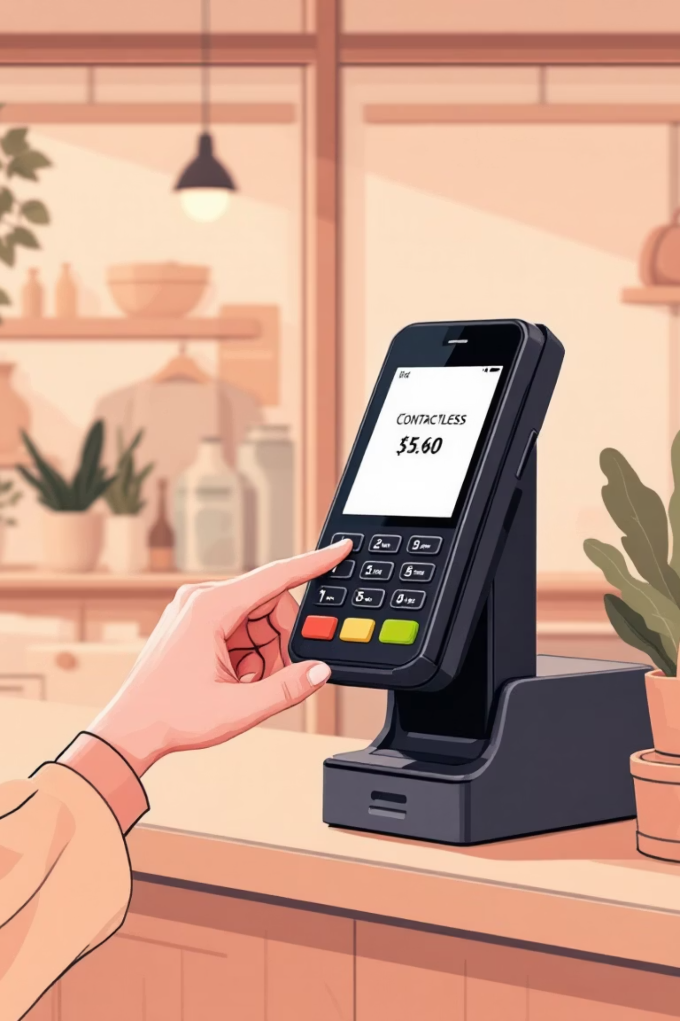
Payment Method Preferences
Credit Card
Cash
339 transactions
338 transactions
Most popular among high-value customers
Nearly equal preference
Debit Card
334 transactions
Strong third option
Top 3 payment methods for customers spending above average

Slide 10




Key Insights & Next Steps
Focus on Subscriptions
Drive subscription adoption for consistent revenue
Clothing Dominates
Optimize inventory across all seasons
Shipping Strategy
Tailor shipping options by location preferences

